Slide 1
CodeBasics Resume Project(Analyzing Market Fit for Air Purifiers)
By Harshal Gharde

Slide 2
Problem Statement:-
AirPure Innovations" is a startup born out of the air quality crisis in India, with 14 cities ranking among the world’s top 20 most polluted urban centers. The company is in the early stages of product development and is unsure whether there is a strong, sustained demand for its air purifier product.

Slide 3
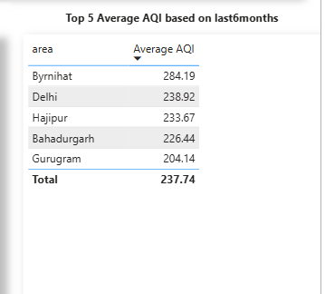
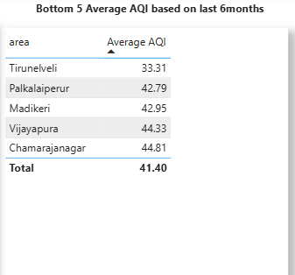
Primary Analysis Insights
Top 5 and Bottom 5 Areas w.r.t average AQI from the period of December 2024-May 2025

Slide 4
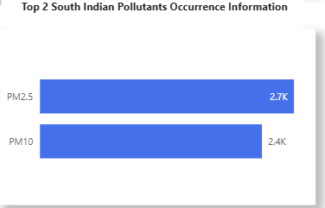
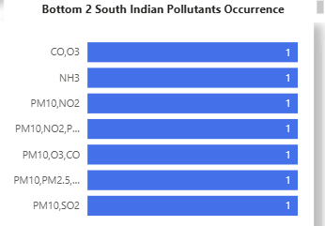
Top 2 and Bottom 2 prominent pollutants for each state of southern India. (Consider data post Covid: 2022 onwards) :Considering Kerala,Tamil Nadu,Karnataka and Andhra Pradesh for analysis

Slide 5
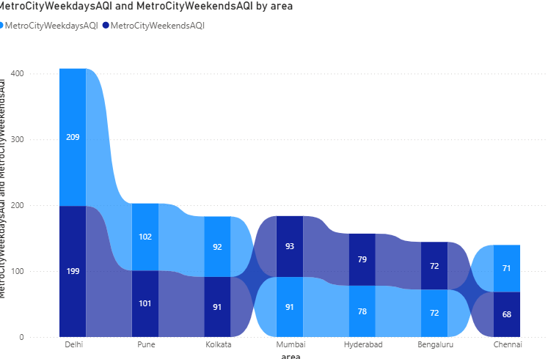
AQI Analysis in Metro Cities(Weekends vs Weekdays for last 1 year: From the analysis Weekend avg AQI drops in Delhi,Pune,Kolkata and Chennai,majorly Delhi

Slide 6
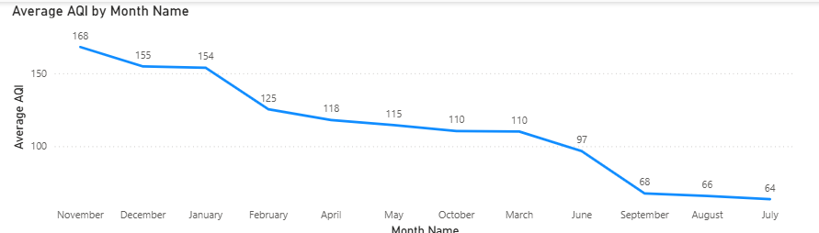
Months consistently show the worst air quality across Indian states — (Consider top 10 states with high distinct areas):Considering Top 10 states with most regions Nov and December shoots up because of festive season ,seasonal changes and stubble burning.

Slide 7
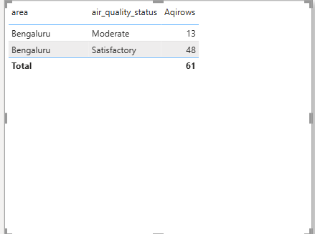
For the city of Bengaluru, how many days fell under each air quality categories: Considering March and April from the dataset because of unavailability of May 2025 we see 79 % days as satisfactory AQI and rest as moderate which can be unhealthy for certain sensitive groups.

Slide 8
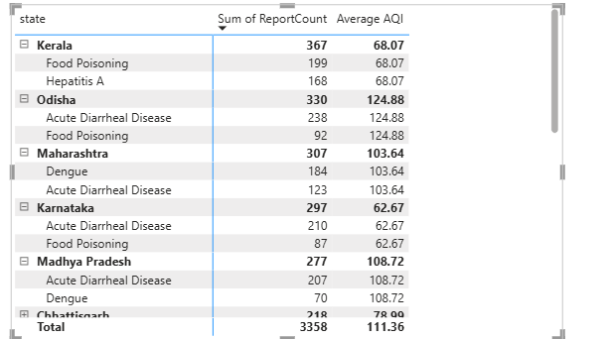
Top two most reported disease illnesses in each state over the past three years, along with the corresponding average Air Quality Index (AQI) for that period:-Top 2 Diseases Count with their avg AQI

Slide 9
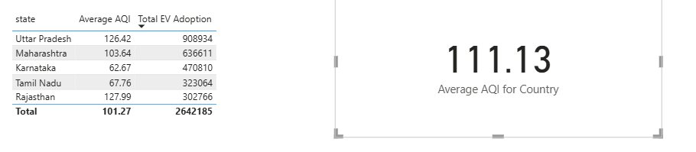
Top 5 states with high EV adoption and if their average AQI is significantly better compared to states with lower EV adoption:-For UP,Maharashtra and Rajasthan Average AQI is close to that of the country but relatively falls for Karntaka and Tamil Nadu so here EV Adoption has helped

Slide 10
Secondary Analysis Insights
Age Group with air pollution related health outcomes:- Children and elderly are the most vulnerable to ill-effects of air pollution. A) Impact of air pollution on children:- Study found out that the children born in the areas where pollutant (PM2.5) levels exceeded the national standard of (40 µg/m³) are nearly twice as likely to die in the first month (OR ≈ 1.86) or later in infancy (OR ≈ 2.04), compared to those in cleaner areas Link to the study:-https://pmc.ncbi.nlm.nih.gov/articles/PMC11333718/

Slide 11
B) Impact of air pollution on Elderly:-
i)Adult mortality (15+) and PM₂.₅ Adults in regions exceeding the PM₂.₅ standard experience a 13% higher odds of death (OR ≈ 1.13) compared to those in cleaner areas.
Link to the study:- https://pmc.ncbi.nlm.nih.gov/articles/PMC11333718/

Slide 12
Major Top Competitors in the Indian Air Purifier Market (2025)
1. Dyson
Positioning: Premium segment
Price Range: ₹30,000 – ₹60,000+
Key Differentiators:
Patented 360° Glass HEPA Filter and Activated Carbon Layer
Air Multiplier™ technology (projects purified air)
Smart features: App control, real-time air quality monitoring, voice assistant compatibility
Design-focused (aesthetic, bladeless)
2. Philips
Positioning: Mid to premium segment
Price Range: ₹10,000 – ₹35,000
Key Differentiators:
VitaShield IPS technology with HEPA and Activated Carbon filters
Removes PM2.5, bacteria, allergens, VOCs
Smart sensors with real-time AQI display
Sleep mode for quiet operation
3. Mi (Xiaomi)
Positioning: Budget to mid-range
Price Range: ₹8,000 – ₹15,000
Key Differentiators:
True HEPA filter (99.97% particles) at a low cost
Smart features: App control (Mi Home), Alexa/Google Assistant support
OLED display with AQI, temperature, and humidity
Excellent value for money

Slide 13
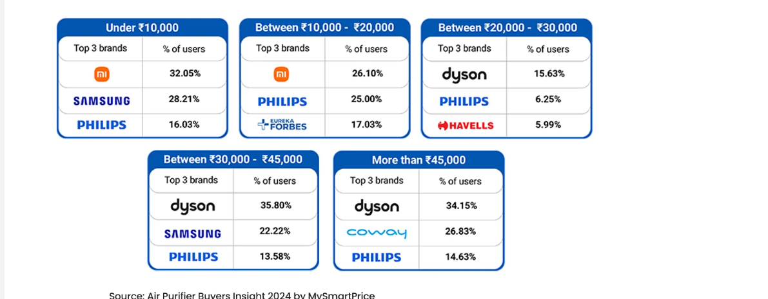
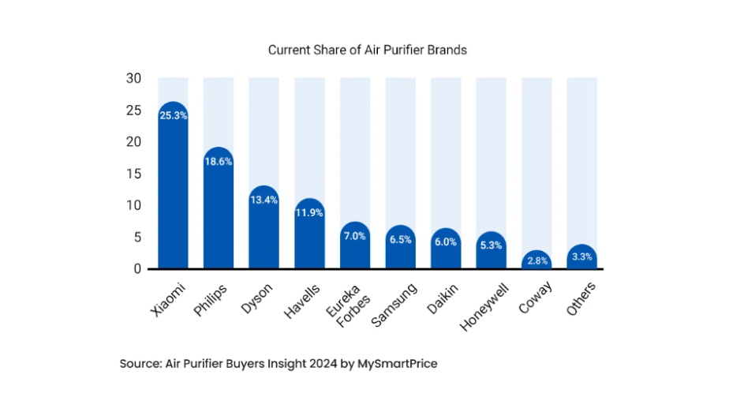
Market Size and Trends Analysis:- After analyzing the trends from January 1 2024 to December 31 2024 we understood that Xiaomi is the Market Leader with around 25.3 % Market Share followed by Philips and Dyson with 18.6% and 13.4% Percent share respectively. Link to this article:-https://www.mysmartprice.com/gear/air-purifiers/air-purifiers-features/msp-air-purifier-survey-2024/

Slide 14
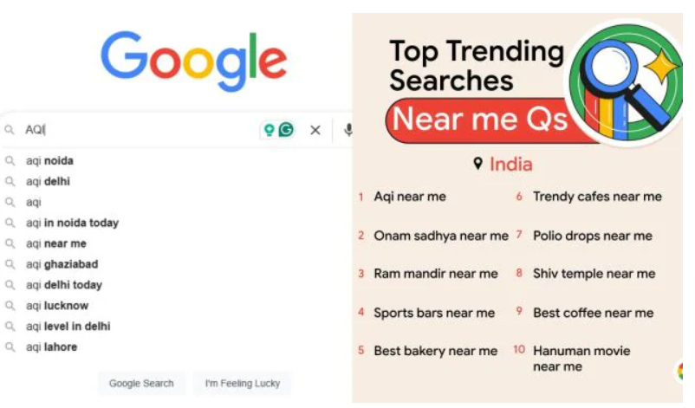
Awareness of AQI Terms across Indians:- i)Article in the Indian Express in 2024 showing the data from Google Trends tell that the most searched terms in the cities Delhi ,Mumbai,Lucknow and Kanpur. experiencing “very poor” to “severe” AQI Levels was “AQI near me”, Link to the article: https://indianexpress.com/article/trending/trending-globally/top-google-search-trends-in-india-2024-aqi-near-me-and-ram-mandir-near-me-lead-the-way-9716528/

Slide 15
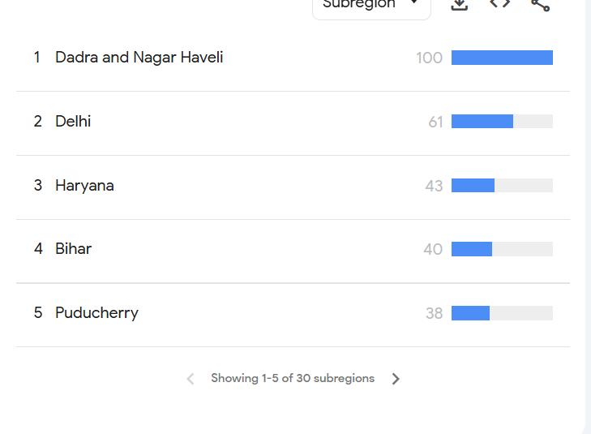
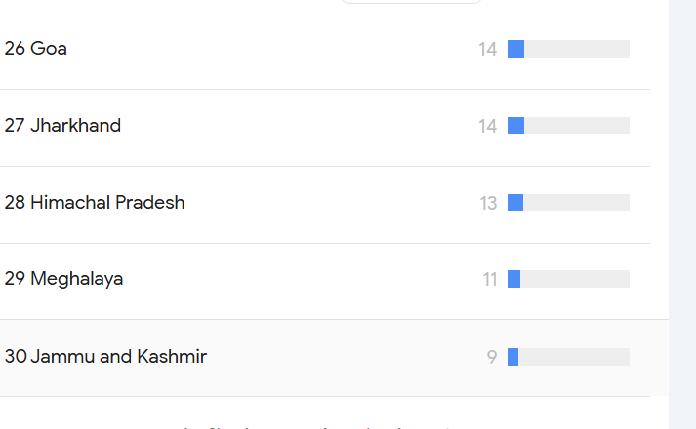
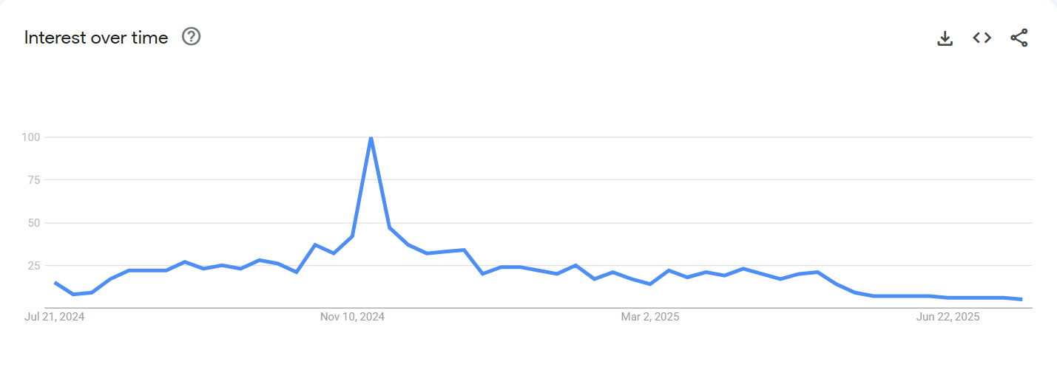

Slide 16
Most Effective Pollution Control Policy (2019–2024)
🛑 Policy: BS-VI Vehicle Emission Norms (April 2020) ✅ Nationwide rollout aimed at reducing vehicular pollution
Key Impacts:
i)Introduced cleaner fuel (10 ppm sulphur) & stricter engine standards
ii)Reduced PM2.5 and PM10 emissions significantly in metro cities iii)City-wise Impact:
Kolkata: ~40% drop in PM2.5 (best improvement)
Mumbai: ~25–30% reduction
Delhi & Lucknow: Limited impact due to stubble burning, weather, and industrial sources
📌 Conclusion: BS-VI was India’s most impactful nationwide policy for air quality improvement in the past 5 years, with effectiveness varying by local pollution sources and enforcement. Link to the article:-https://www.sciencedirect.com/science/article/abs/pii/S1361920922004291?utm_source=chatgpt.com

Slide 17
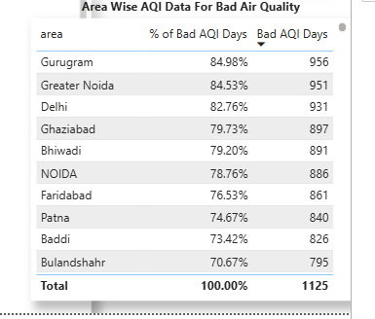
Answering critical questions
Priority Cities: Tier1/2 cities showing irreversible AQI degradation? i)After analyzing the AQI dataset of 1125 distinct dates we got these 7 tier1/tier 2 cities with most bad aqi days excluding(bhiwadi,baddi and bulandshar)-tier3 cities . ii)Bad AQI Days:- Days excluding AQI types(Good,Satisfactory) iii) As these 7 cities have complex pollution sources even air pollution poicies do not help

Slide 18
AQI spikes correlation with pediatric asthma:- Multiple studies across Indian cities confirm a strong correlation between rising PM₂.₅/PM₁₀ levels and increased asthma cases in children.- 🔍 Key Evidence:
Delhi Study (Lung India, 2021)
Survey of 4361 children (aged 13–17)
21.7% reported asthma; 29.4% had airflow obstruction
Highest rates in Delhi due to severe pollution Link :-https://pmc.ncbi.nlm.nih.gov/articles/PMC8509169/ Mysore Time-Series Study (MDPI, 2023)
362 children tracked (mean age: 5.3 years)
2.8% increase in asthma admissions for every 10 µg/m³ rise in PM₁₀. Link:-https://pubmed.ncbi.nlm.nih.gov/37628320/ Delhi Hospital Data (DPCC Report via HT)
Every 10-unit PM₂.₅ spike → ~7 more respiratory admissions/week (incl. asthma) Link:-https://www.hindustantimes.com/cities/others/every-10-unit-rise-in-pm-levels-leads-to-7-hospital-admissions-in-delhi-dpccstudy-101624472444345.html

Slide 19
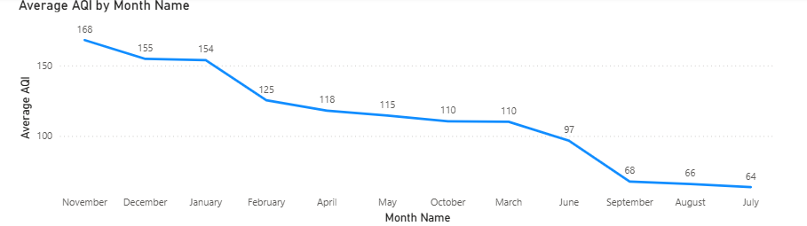
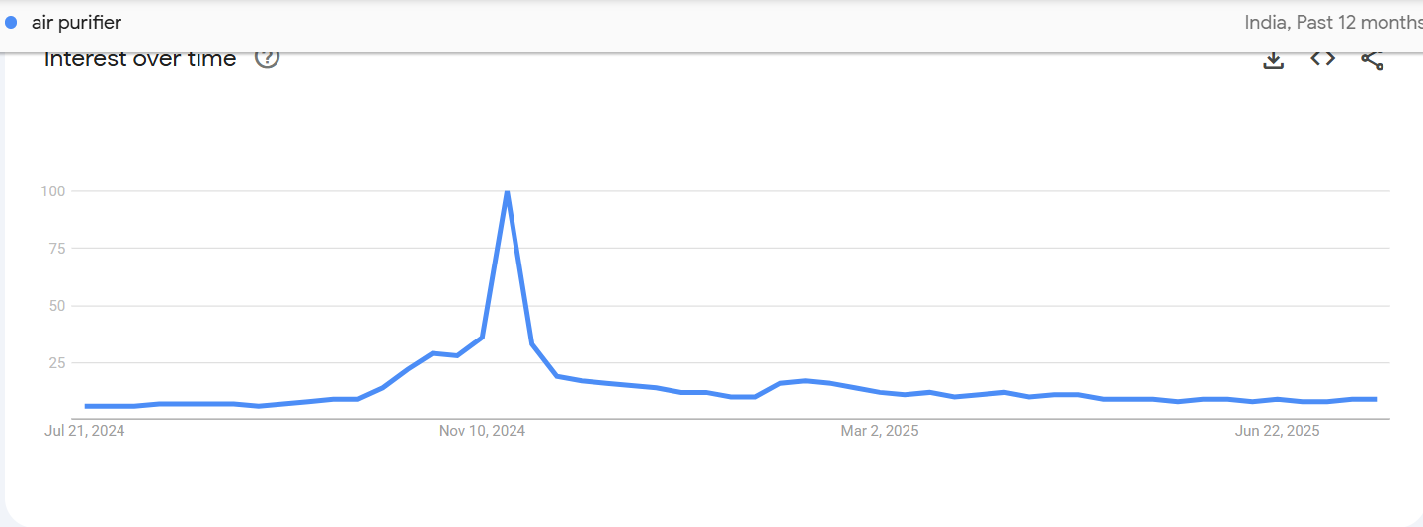
Pollution Emergencies and Correlation with Google Search Trends:-

Slide 20
✅ Slide 1: Gaps in Smart AQI Syncing & Compact Design
Smart AQI Syncing:
✔ Available in premium brands like Dyson, Philips, Mi
❌ Missing in most budget models
⚠ Some devices only show PM2.5, not full AQI or outdoor syncing
Compact Design:
✔ Found in Mi, Honeywell, Sharp
❌ High-end models like Dyson are bulky
⚠ No wall-mountable or modular options
🟨 Insight: Need for smart syncing in budget devices and more space-saving designs for urban homes.

Slide 21
Recommendation for Product Development– 3-in-1 Air Purifier (Purify + Heat + Cool)
Europe (e.g., Blueair T10i):
✔ Combines purifier + heater + fan
✔ Smart control, year-round use, energy efficient
India Market:
❌ No 3-in-1 models available
❌ Users need separate appliances
🟢 Opportunity: Launch a compact 3-in-1 purifier tailored for Indian seasons — with smart controls and modern design.

Slide 22
Thank YOU

